Slide 1

PORTAGE APL
GROUP 14:
NIKITHA CHIGURUPATI
GAYATHRI YENIGALLA
RAJEEV VARMA
SAI KIRAN

Slide 2
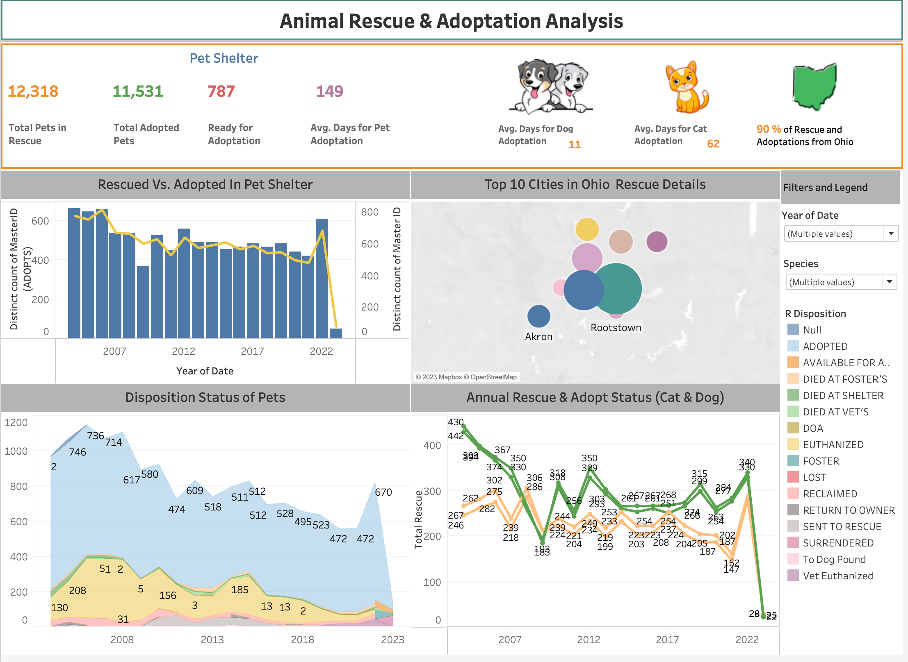
BRINGING PETS AND PEOPLE TOGETHER: The dashboard provides a clear picture of the shelter's adoption efforts and the progress made in saving the lives of animals in need.

Slide 3
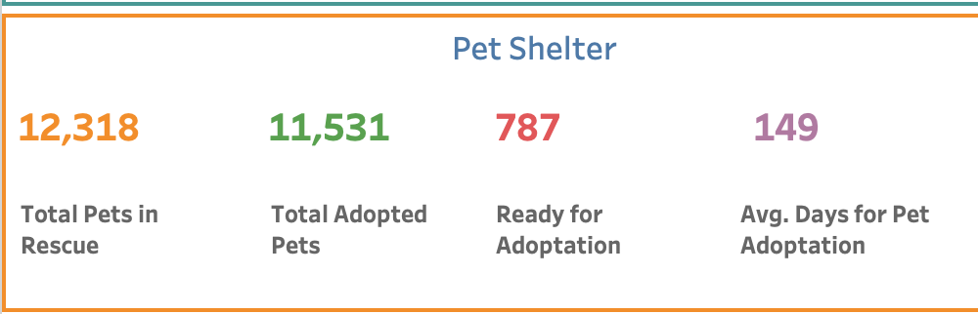
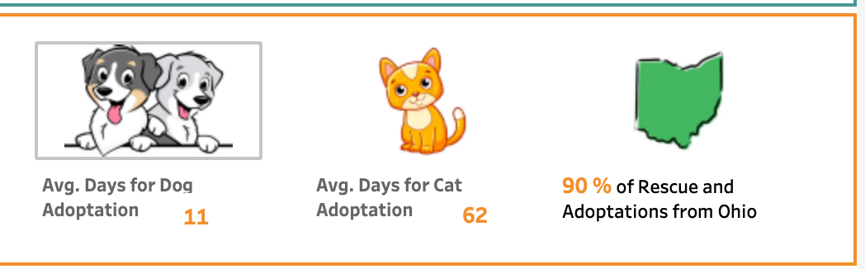
PAWSITIVELY IMPACTFUL : TRACKING ADOPTION EFFORTS The data on ready-for-adoption animals also gives potential adopters an idea of the variety of animals available and the opportunity to find a loving companion that fits their lifestyle.

Slide 4
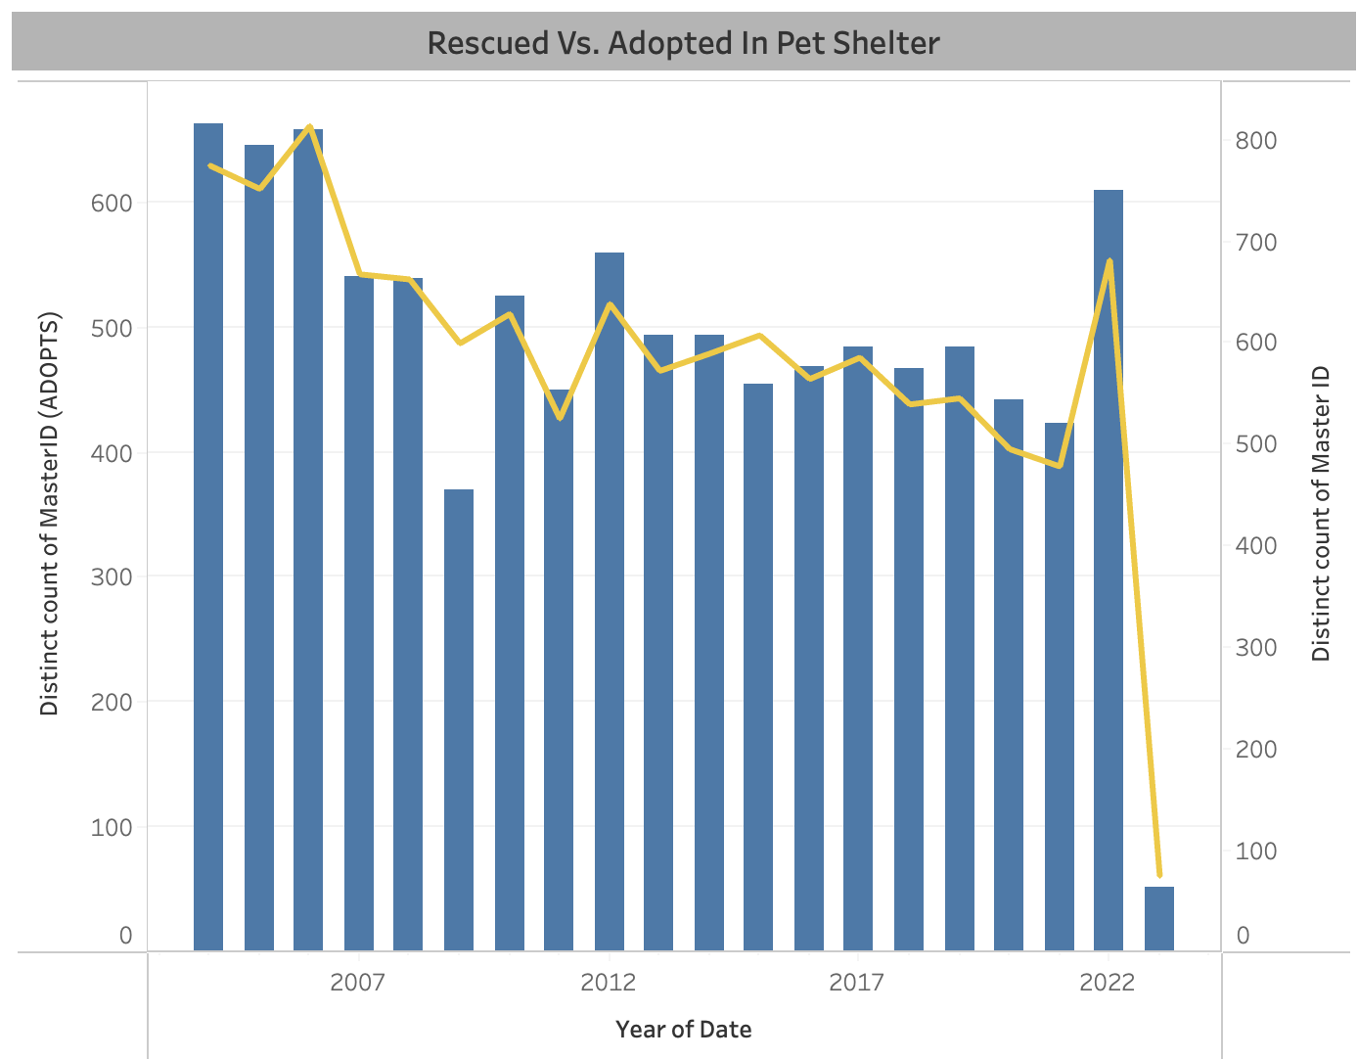

SAVING THE FURRY FRIENDS: DUAL GRAPH OF RESCUES AND ADOPTIONS If the number of adoptions is consistently high, it may indicate that the shelter has effective adoption policies and programs in place. If the number of adoptions is low, it may suggest that the shelter needs to improve its adoption strategies, such as by increasing public awareness or offering incentives for adoption.

Slide 5
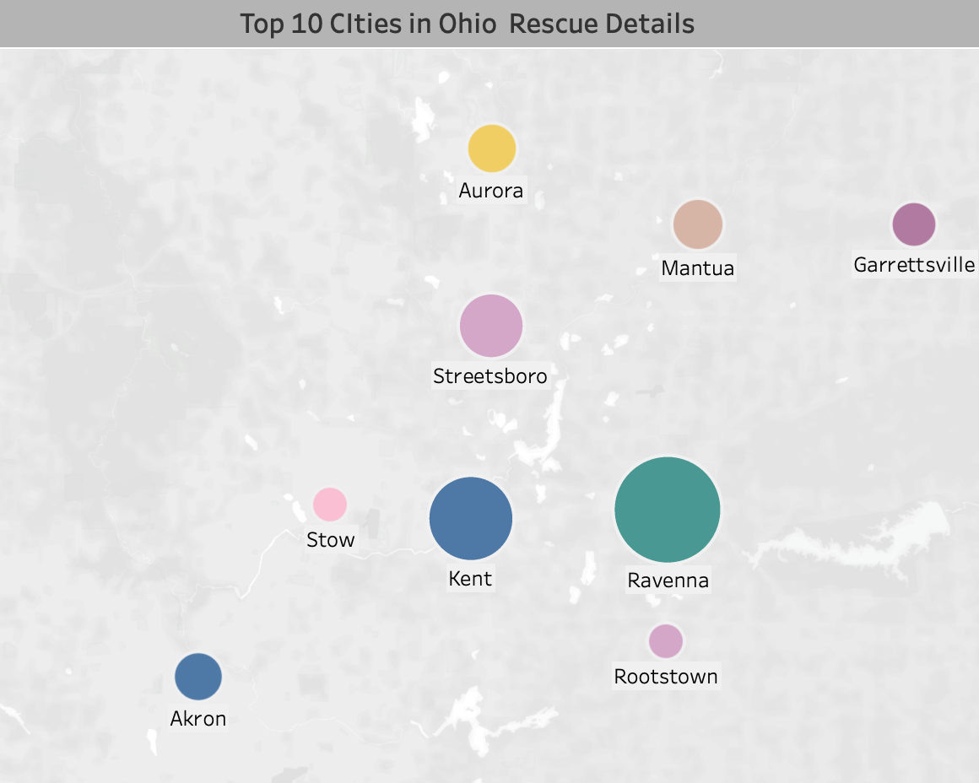
A HOME FOR EVERY PET: MAPPING THE TOP CITIES OF ANIMALS The top cities mapping provides a valuable tool for animal adoption agencies and shelters to improve their outreach efforts and increase the number of animals that find loving homes.

Slide 6
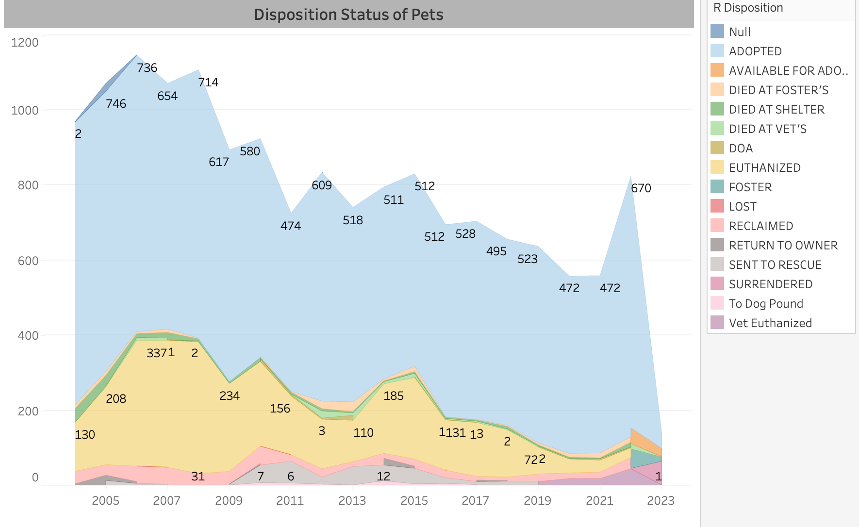
FROM STRAY TO SAFE: GRAPH OF ANIMAL DISPOSITION STATUS
The disposition status is used to track the overall welfare of pets in the location and to help inform decision-making about how to allocate resources.
By comparing the number of pets in each disposition status over time, the graph can provide insight into the effectiveness of the organization's programs and policies for pet welfare.

Slide 7
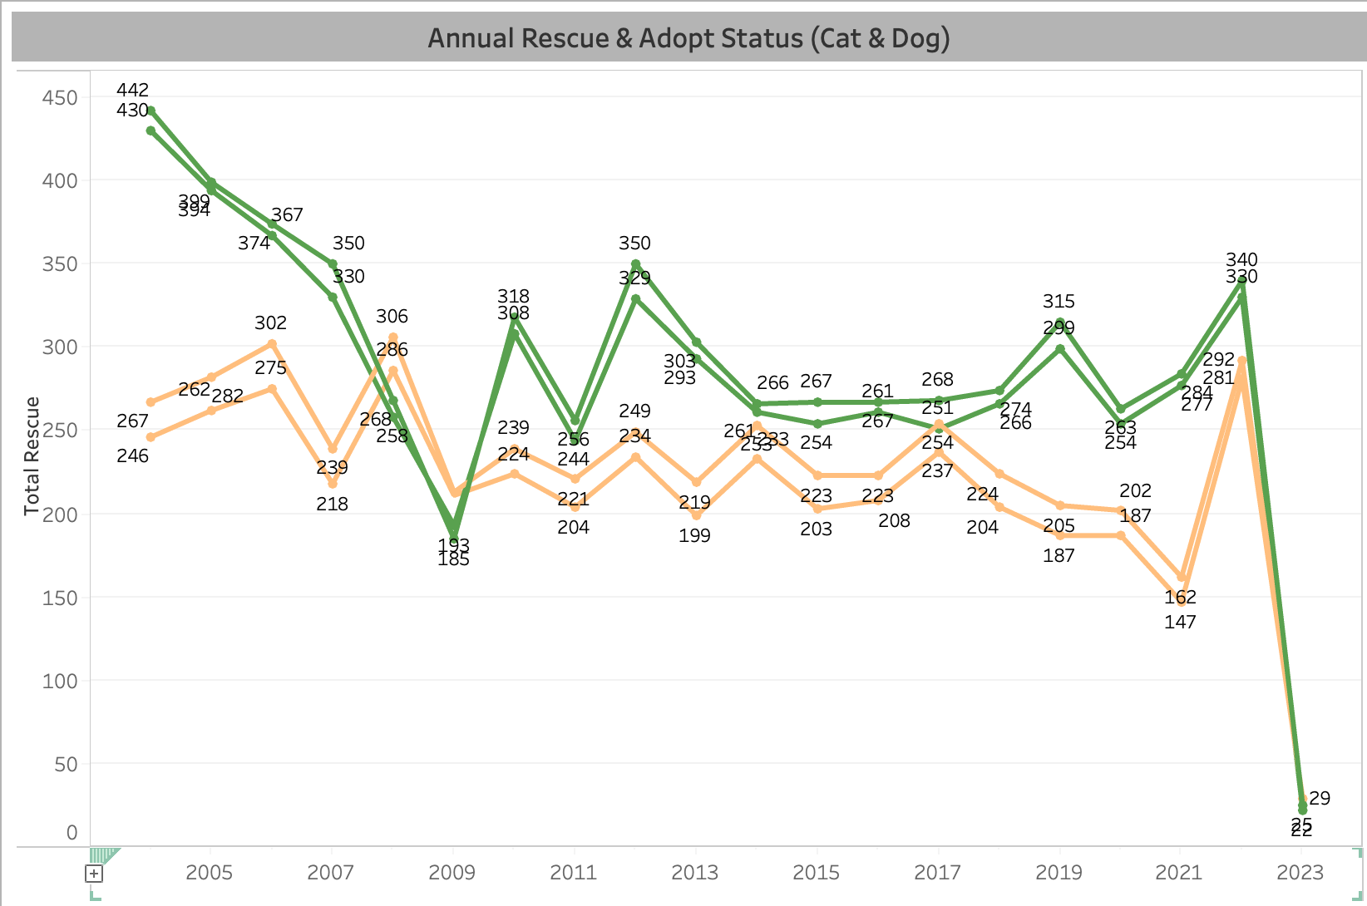
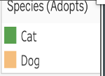
TAILS OF RESCUE AND LOVE: LINE CHART OF ANIMAL ADOPTION AND RESCUE It can help identify areas for improvement and determine whether the organization is effectively achieving its mission to improve animal welfare. Organizations can work towards improving the welfare of cats and dogs and reducing the number of pets that are homeless or euthanized.

Slide 8
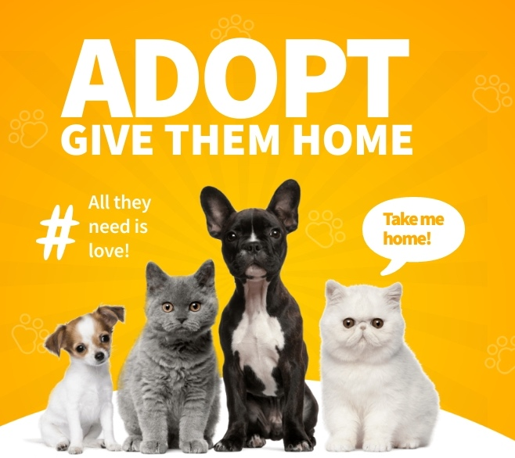
RECOMMENDATIONS:
Making a difference with Every share: Social Media campaigns for adoption.
Finding Forever Homes faster: Streamlining Adoption Programs.
Collaborating for a cause: Partnering with organizations for adoption.
Preventing Homelessness : Offering low-cost spay and neuter programs
Committed to care : Supporting Adopters every step of the way.
Join the Cause: Inspiring volunteer Participation.

